Slide 1
Introduction to Deep learning
Yidong Ouyang

Slide 2
Deep learning Basic
Logistic Regression
Gradient Descent
Neural network
Regularization
Optimization

Slide 3
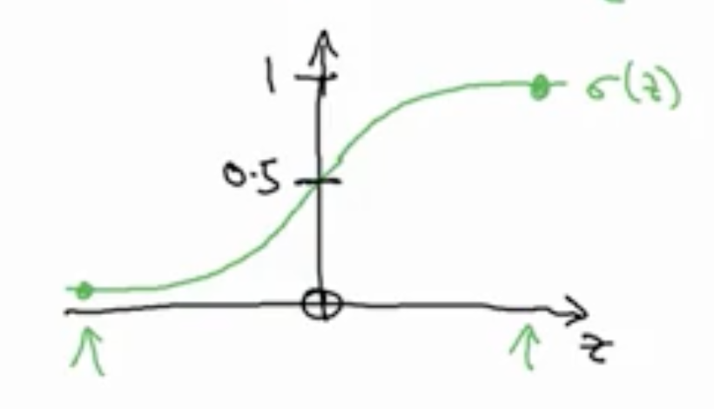
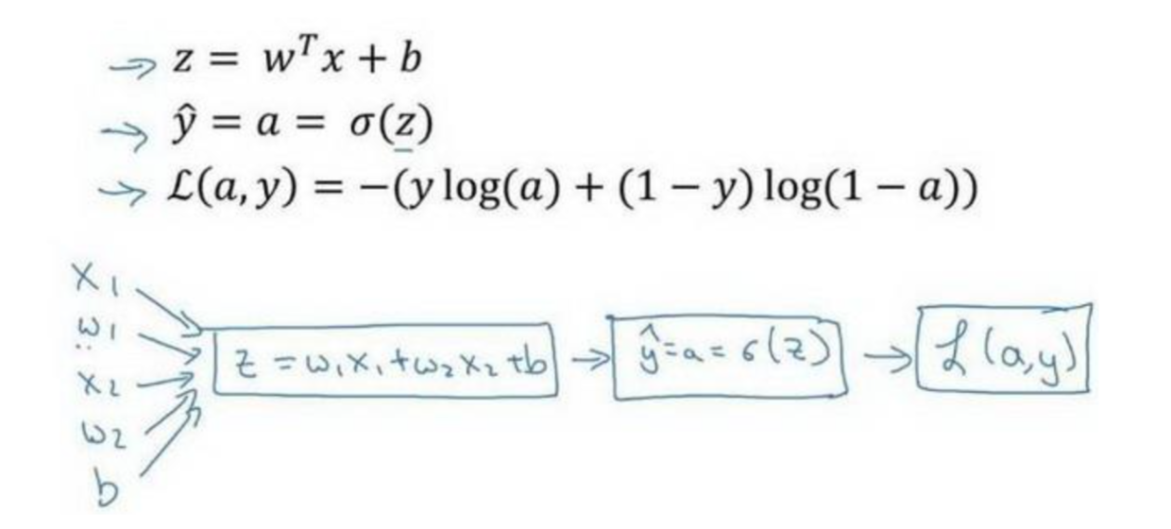
Logistic Regression

Slide 4
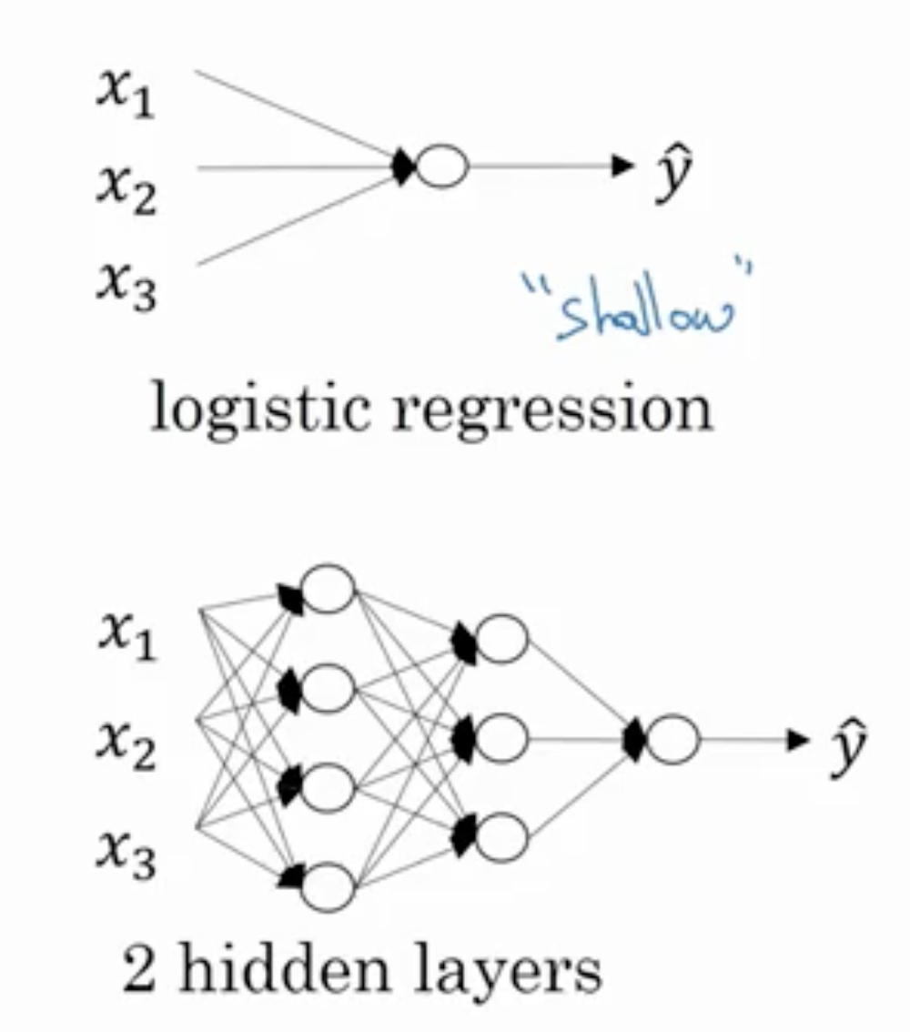
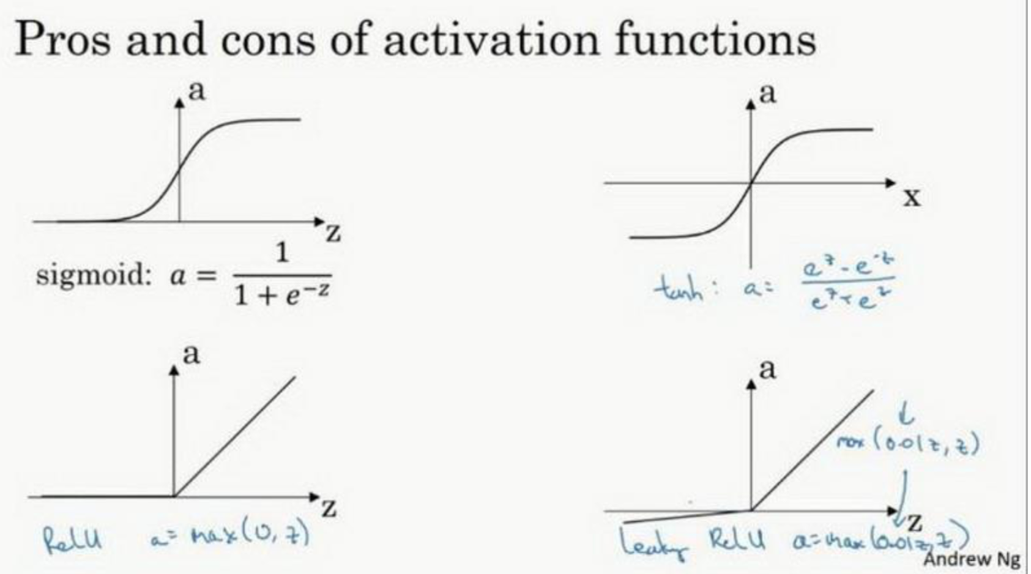
Neural network

Slide 5
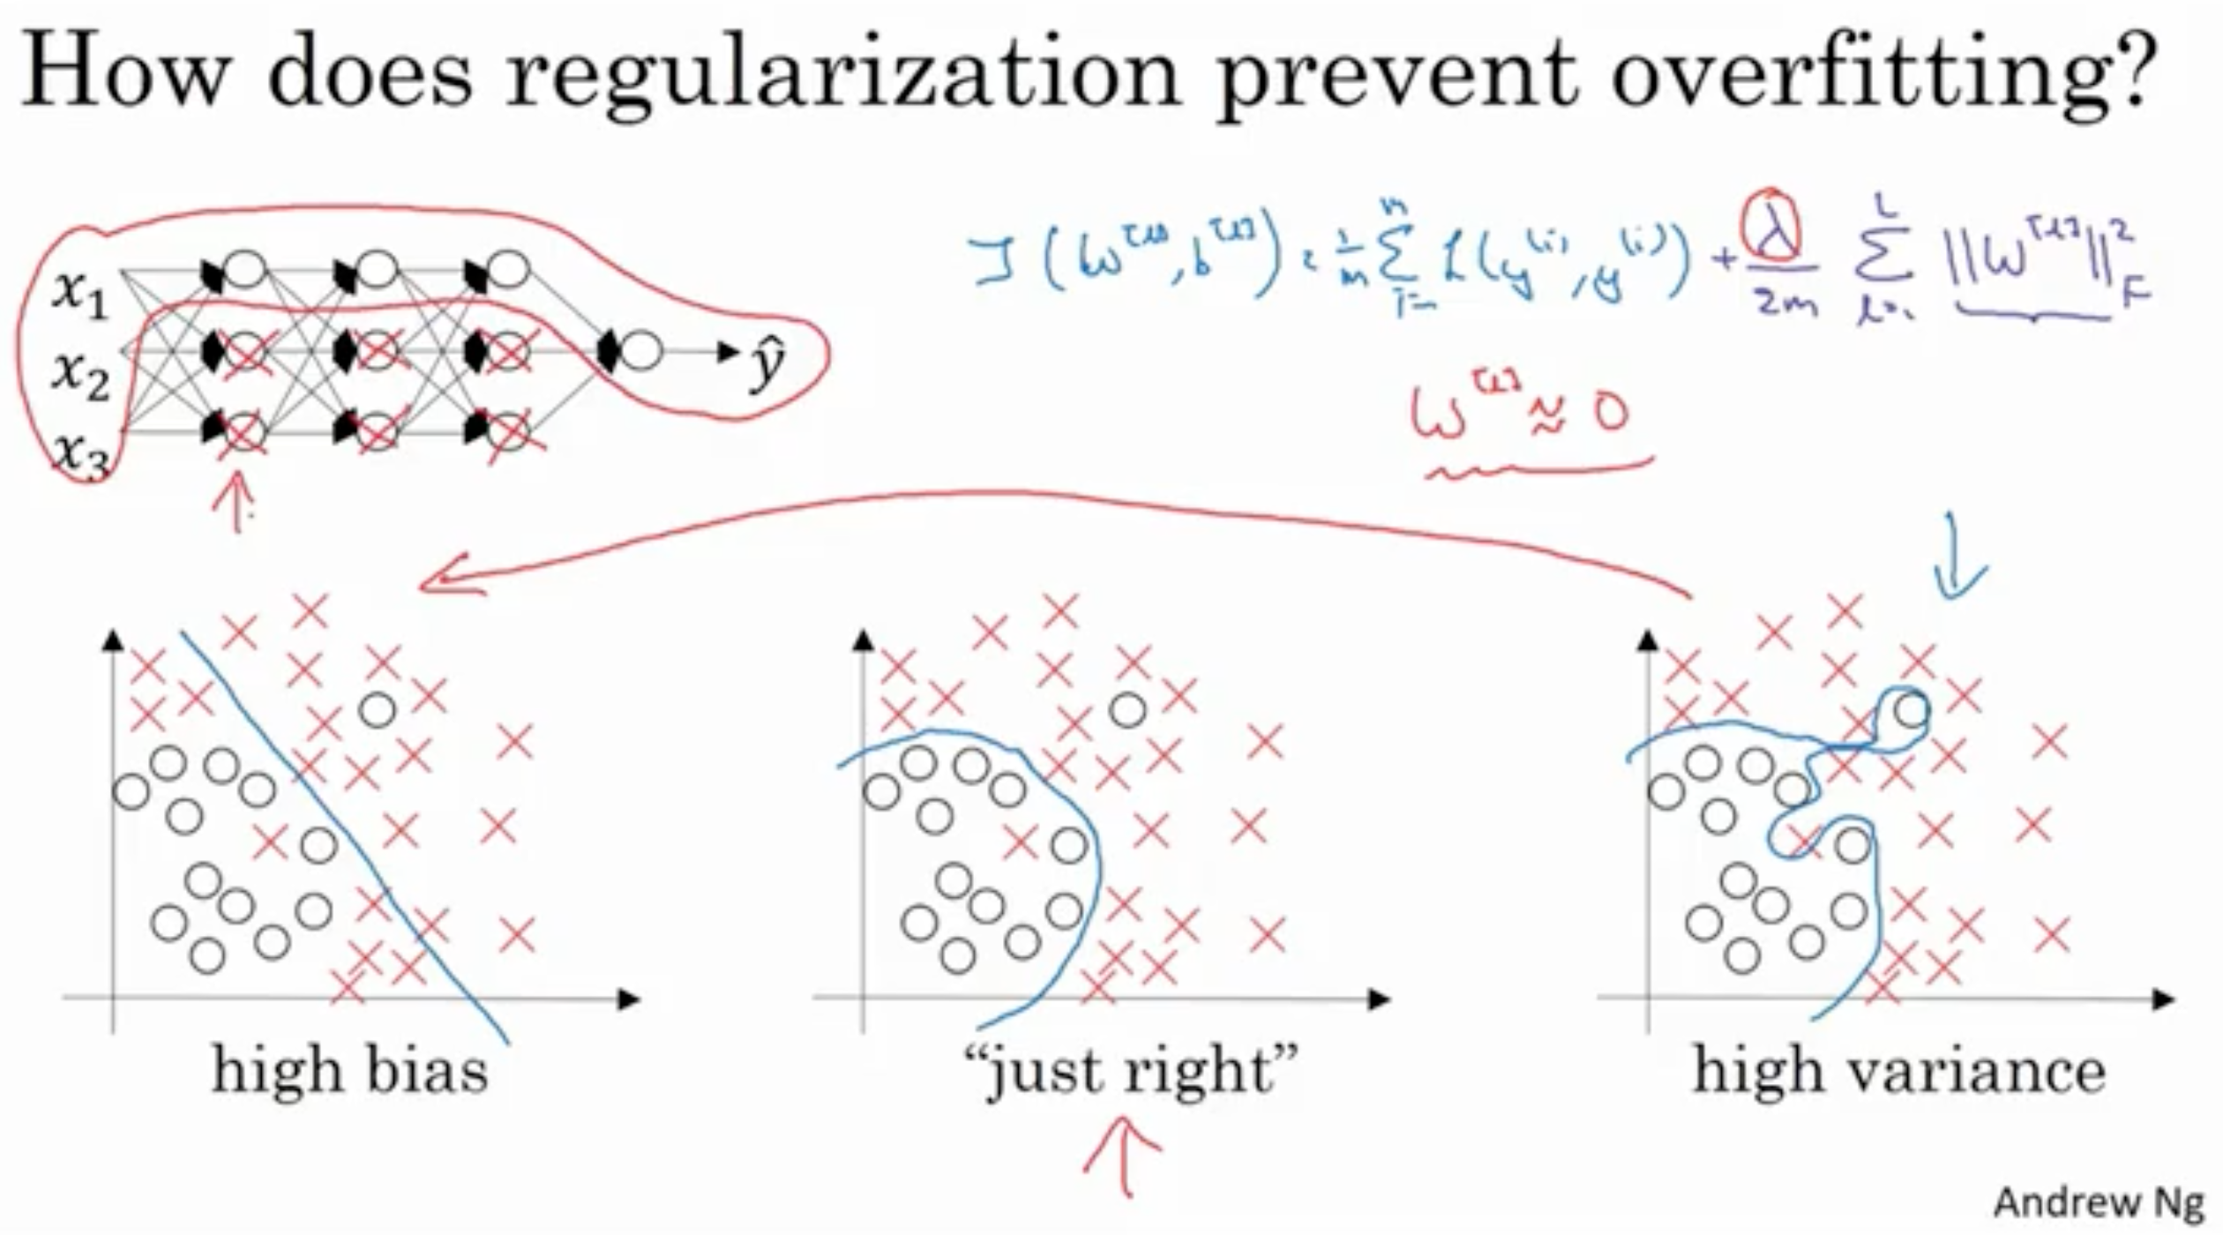
Regularization
Dropout
Weight Decay (l2 norm)
Data augmentation
Batch Normalization
Early stopping

Slide 6
Optimization
https://video.zhihu.com/video/1109019791142236160?
SGD
SGD+momentum
Adagrad
RMSprop
Adam

Slide 7
Computer Vision
Convolutional Neural Network
Image classification
Object detection

Slide 8
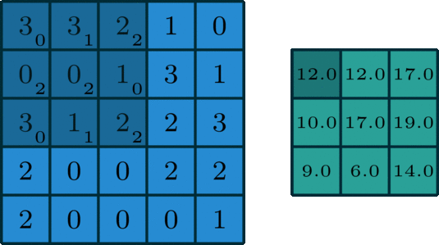
Convolutional Neural Network

Slide 9
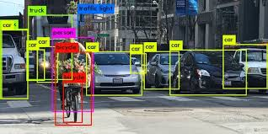
Object detection

Slide 10
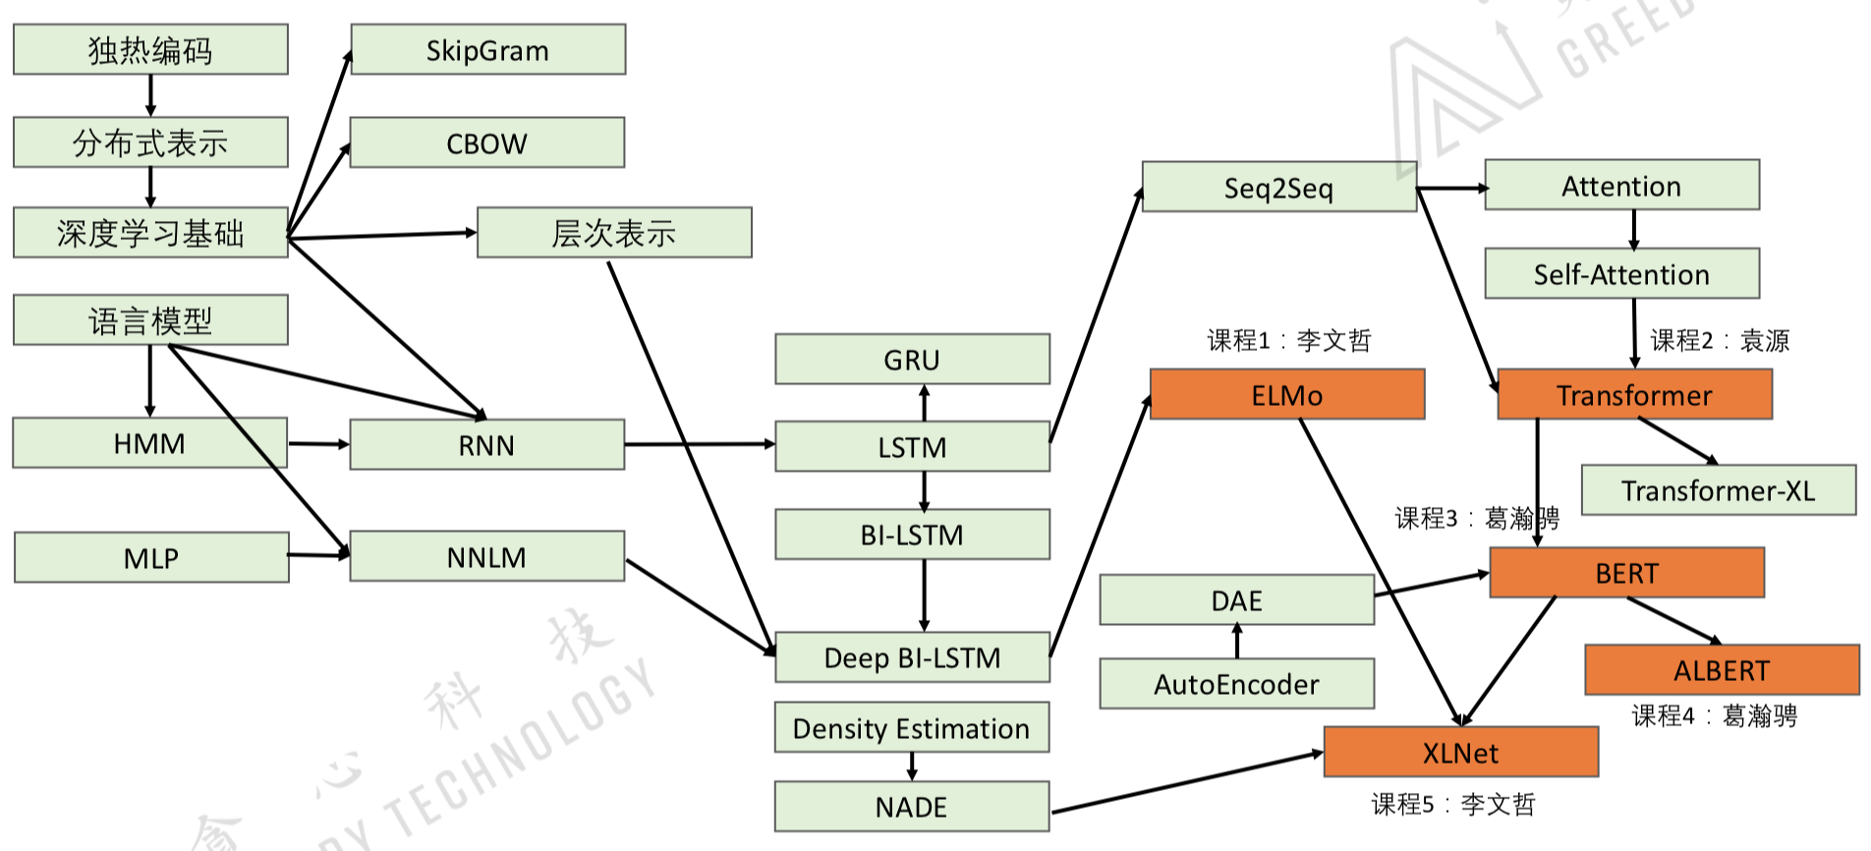
Natural Language Procession

Slide 11
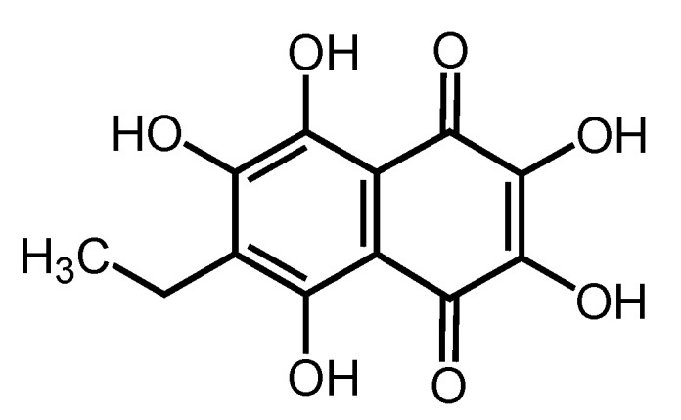
Graph Neural Network
处理node+edge 处理关系
分子、人与人之间的社交、广告
Classification
Generation

Slide 12
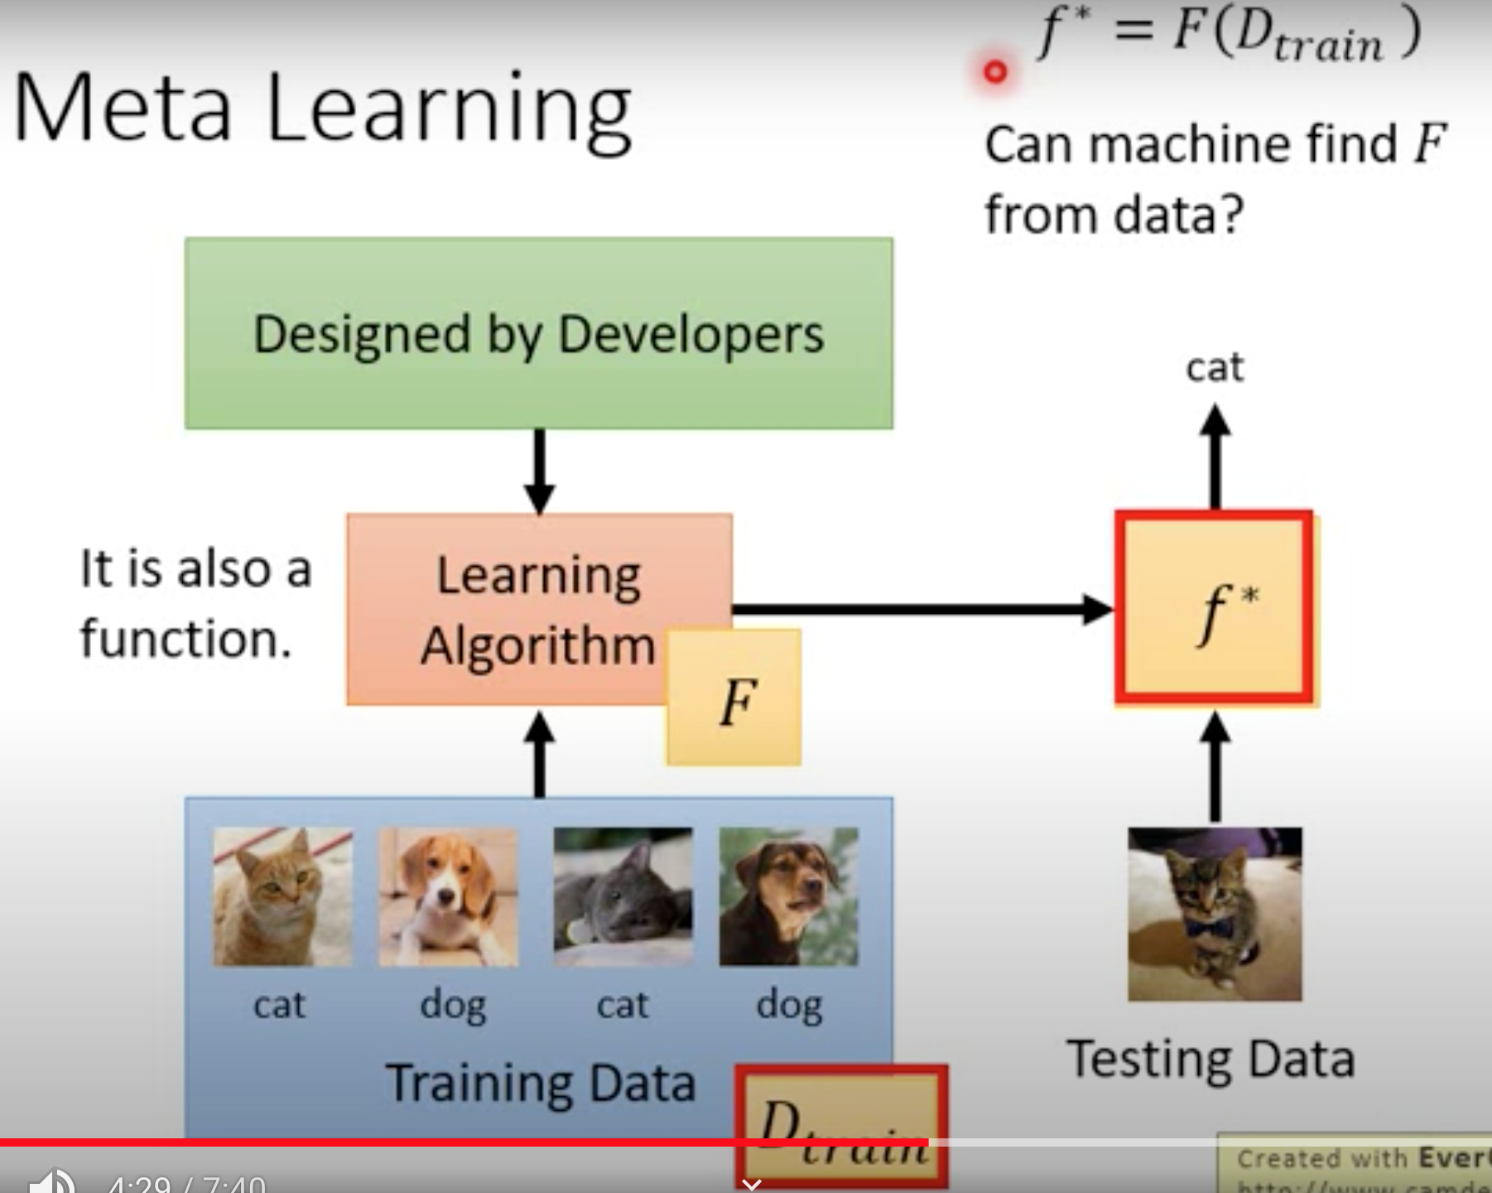
Meta learning

Slide 13
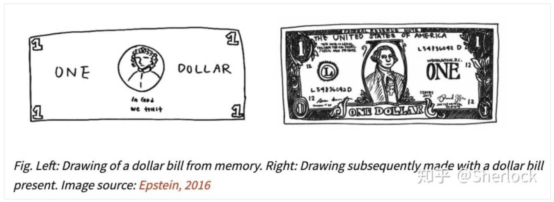
Self-supervised learning
Generative methods
Unsupervised learning
Contrastive methods

Slide 14
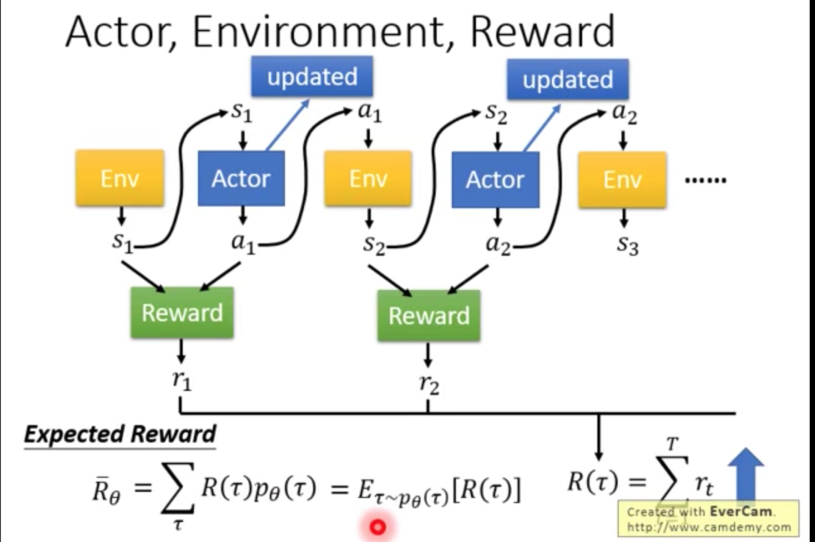
Deep Reinforcement Learning
Policy Gradient
PPO
Q-learning
Actor-Critic
Sparse Reward
Imitation learning

Slide 15
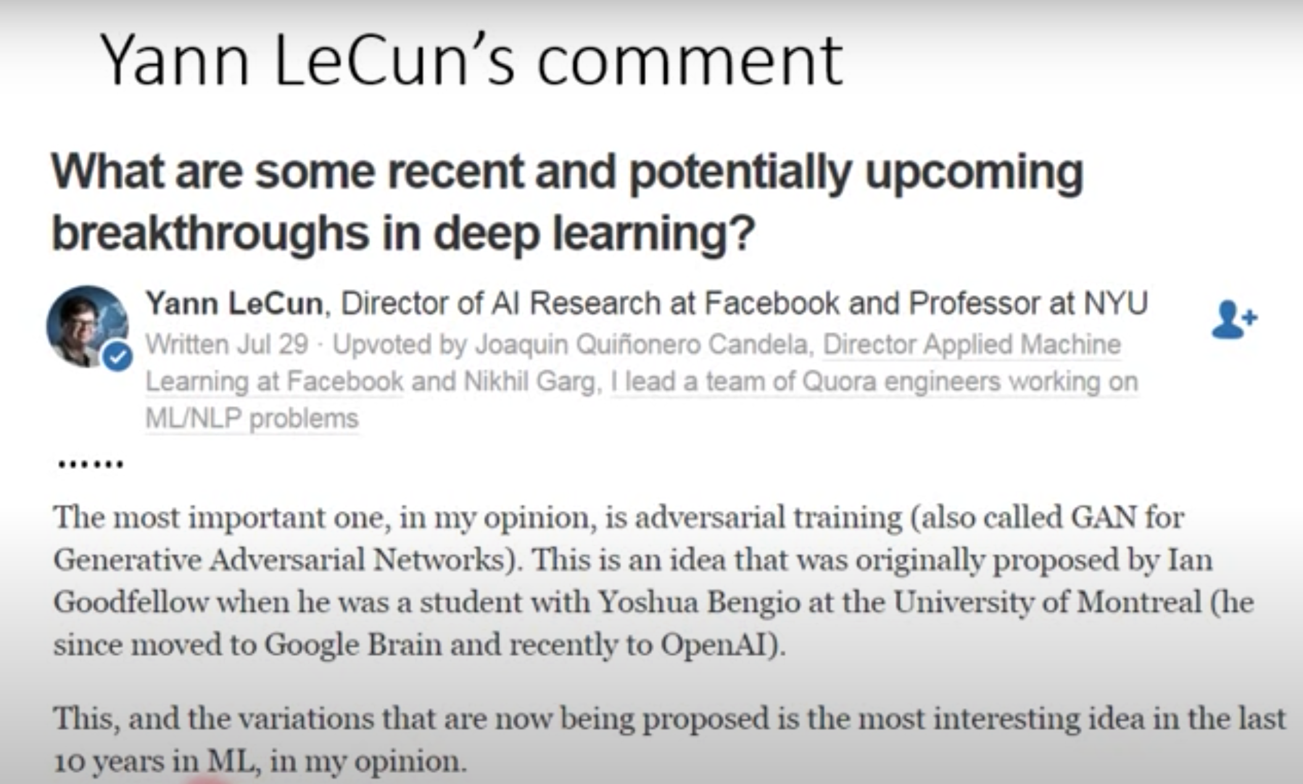
Generative Adversarial Network
Text-to-Image
Image-to-Image
Speech enhancement
Video generation

Slide 16
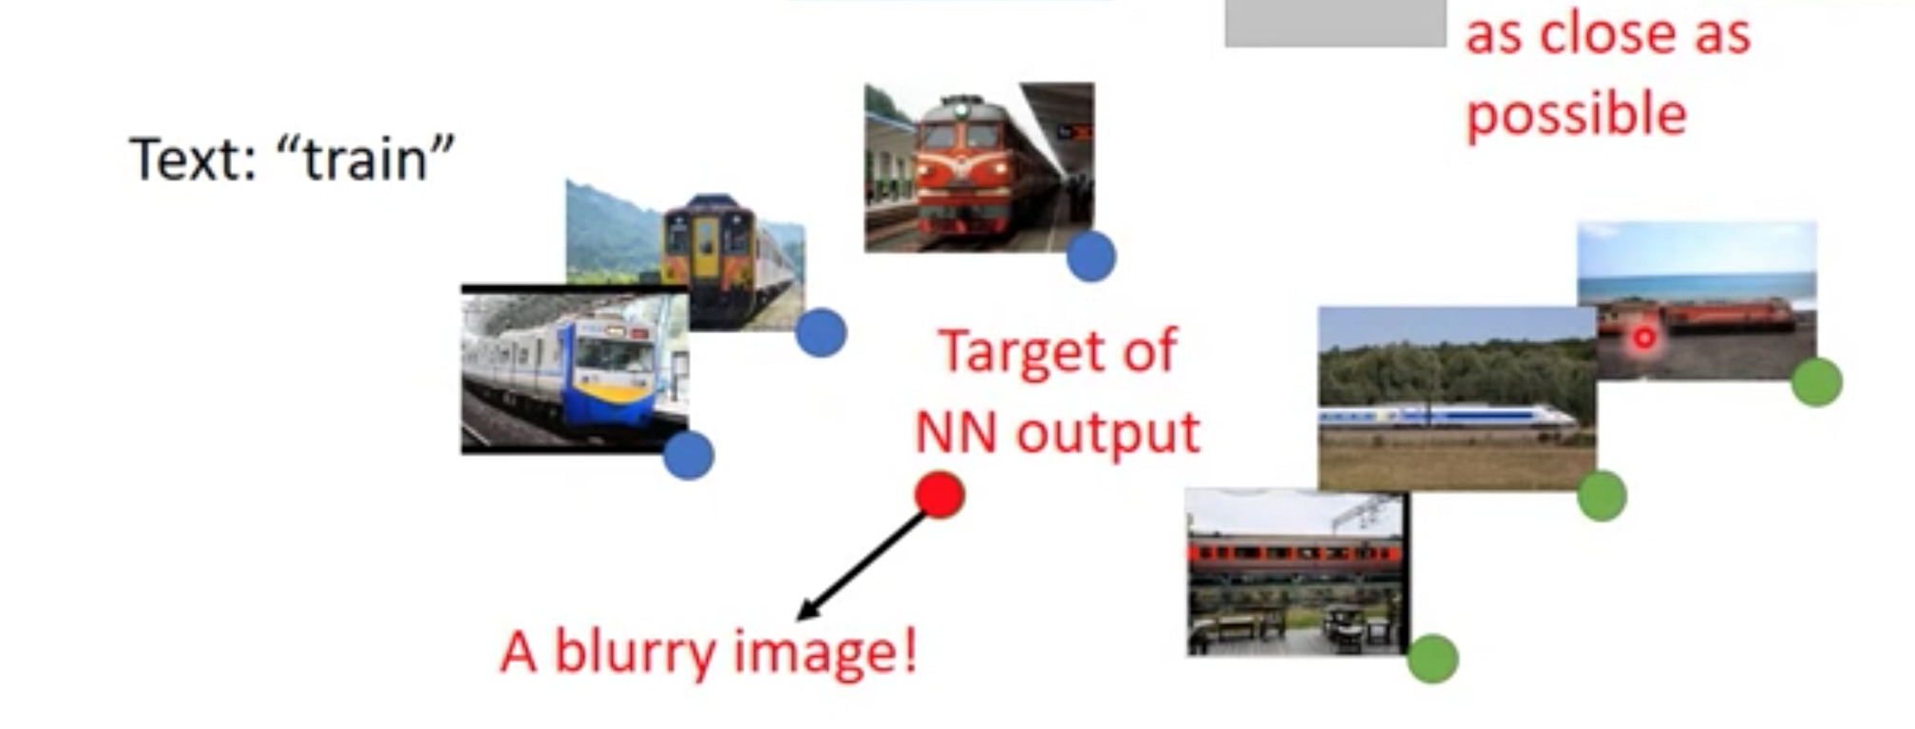
Why we need GAN

Slide 17
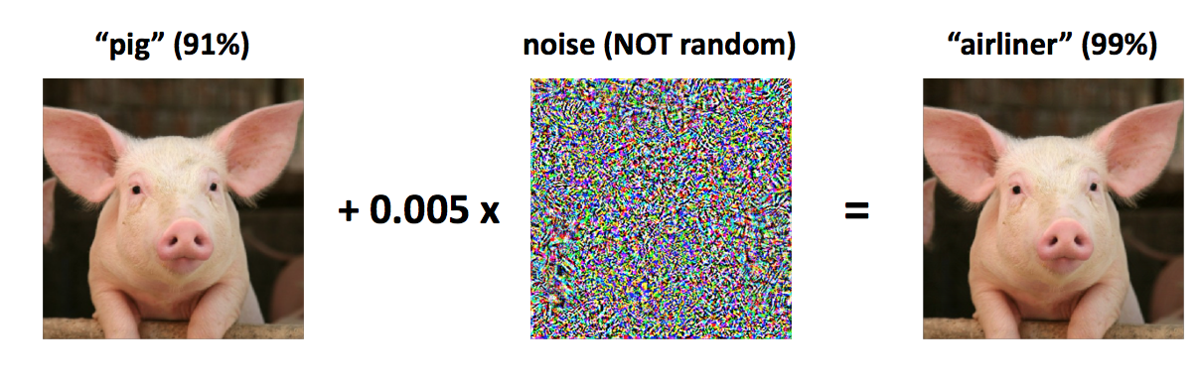
Adversarial examples

Slide 18
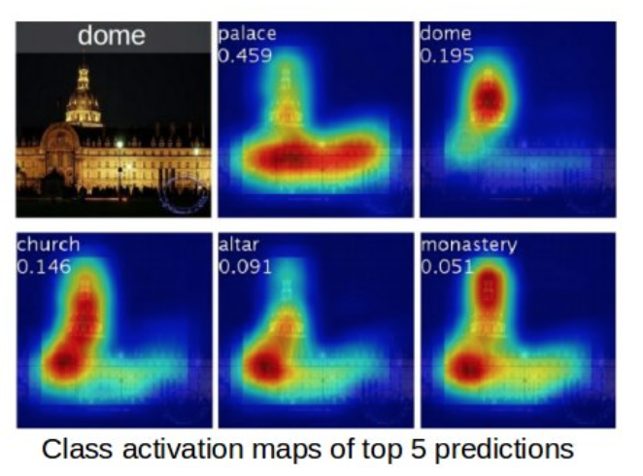
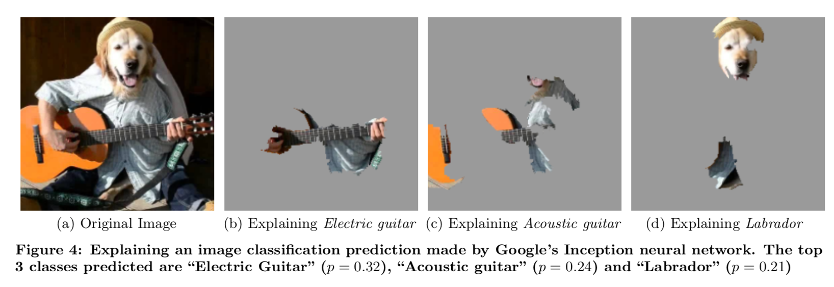
Explained AI
Gradient based
Permutation based

Slide 19
Tips
1.时间规划
2.选好自己想做的方向，focus on it
3.深入探究的精神
4.用实验作为验金石
推荐的学习资料：
https://www.kaggle.com/learn/overview
https://www.coursera.org/specializations/deep-learning#courses
https://www.youtube.com/channel/UC2ggjtuuWvxrHHHiaDH1dlQ

